Slide 1
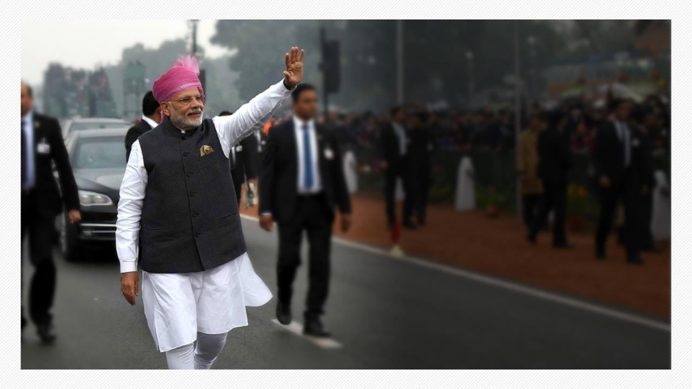
Photo Album
Speed, Scale and Spectrum
of Transforming India
by Windows User

Slide 2
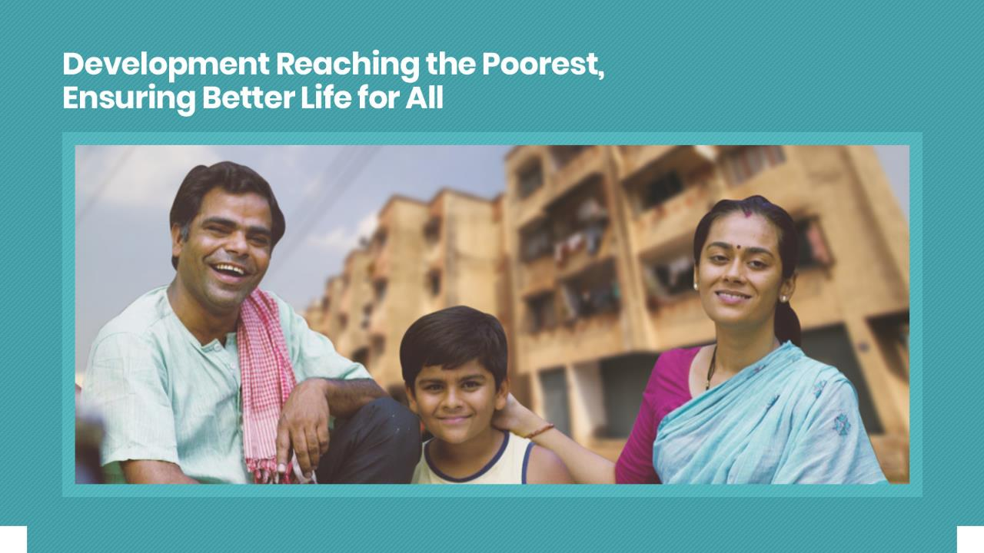

Slide 3
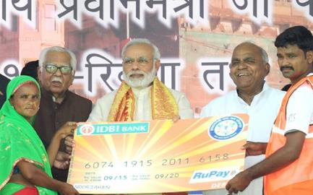



v
DEVELOPMENT FOR ALL
Jan Dhan Yojana Serving the Banking Needs of the Unbanked
34.03 Crore
Jan Dhan accounts opened
According to the World Bank Findex Report, India accounts for
55% of new bank accounts opened globally between 2014-17
India Post Payments Bank launched taking banking system to doorstep of poor & unbanked. Over 1.25 Lakh Access Points rolled out in 4 months
As on 1st February 2019

Slide 4
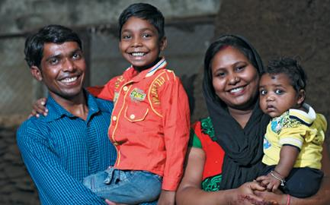




v
DEVELOPMENT FOR ALL
Jan Suraksha Yojana Gives Insurance to Poor
14.64 crore persons insured under PM Suraksha Bima Yojana at ₹12 per year
PM Jeevan Jyoti Bima Yojana benefitted 5.67 crore families at ₹330 per year
Atal Pension Yojana, for unorganised sector workers, has more than 1.37 crore subscribers
Financial security of senior citizens with PM Vaya Vandana Yojana, gives 8% interest for 10 years. Investment limit doubled to ₹15 lakh and scheme extended till 2020
As on 1st February 2019

Slide 5
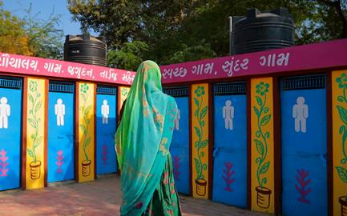



v
DEVELOPMENT FOR ALL
Swachh Bharat Mission Brings about a Sanitation Revolution
Rapid construction of toilets ensuring dignity of women & eradicating open defecation
Over 5.48 lakh Villages in 27 States & UTs declared Open Defecation Free
Over 9.74 crore
Toilets built
Sanitation coverage increased from 38.70% in 2014 to 98.82% at present
As on 1st February 2019

Slide 6
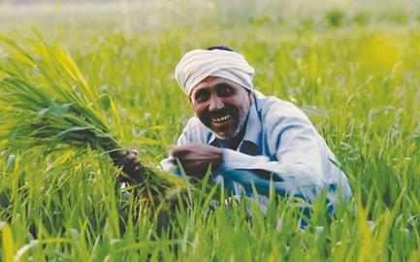
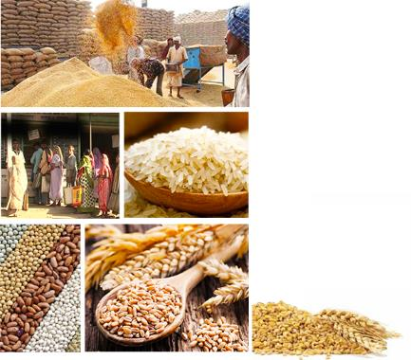
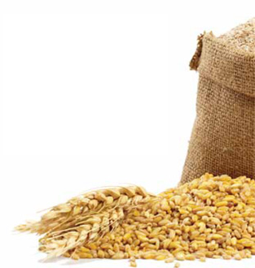
v
DEVELOPMENT FOR ALL
Ensuring Food Security for more than 80 Crore People
Food security
ensured in all the
36 States/UTs
as against 11 states
in May 2014
As on 1st February 2019

Slide 7




v
DEVELOPMENT FOR ALL
Direct Benefit Transfer Ensuring Money in Account, Removing Middlemen
World’s largest cash transfer program with over
₹6,06,473 crore
About 8 crore fictitious beneficiaries removed
23.67 crore
directly transferred
into bank account of
beneficiaries of 437 schemes
beneficiaries receiving over ₹1,04,045 crore
As on 1st February 2019

Slide 8
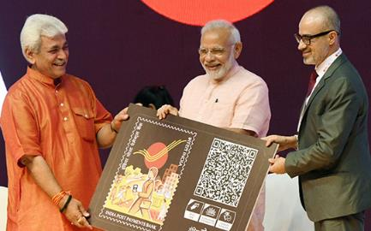



v
DEVELOPMENT FOR ALL
India Post Payments Bank
Delivering Doorstep Banking to the Unbanked
Launched on 1st September, 2018
Over 30 lakh
accounts opened,
21 lakh transactions
performed worth over ₹800 crore
IPPB offers savings & current accounts and services like Mobile/Phone Banking, SMS Banking, bill payments, DBTs
3 lakh Postmen &
Gramin Dak Sevaks
delivering IPPB services
As on 1st February 2019

Slide 9
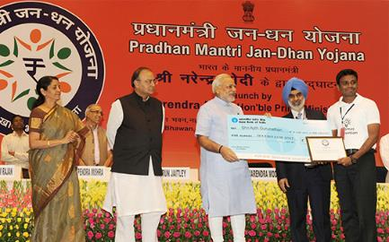






v
DEVELOPMENT FOR ALL
Boost to Financial Services with PM Jan Dhan Yojana
Accidental insurance
cover for new RuPay card
holders raised from
`1 lakh to `2 lakh
Overdraft limit
raised from
`5000 to `10,000
No conditions for
overdraft
up to `2000
Accidental insurance
cover for new RuPay card
holders raised from
₹1 lakh to ₹2 lakh
Overdraft limit
raised from
₹5000 to ₹10,000
No conditions for
overdraft
up to ₹2000
Age limit for availing
overdraft facility increased from
18-60 to 18-65 years
Age limit for availing
overdraft facility increased from
18-60 to 18-65 years
As on 1st February 2019

Slide 10
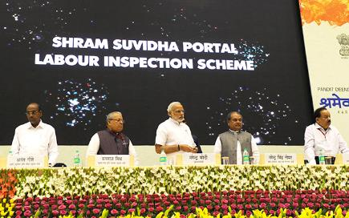




v
DEVELOPMENT FOR ALL
Shramev Jayate: Upholding Dignity of Labour
Budget 2019-20 Proposal
PM Shram Yogi Maandhan Yojana
Under NPS, share of
Government increased to 14%
To provide assured monthly pension of ₹3000 after 60 years of age with monthly contribution of ₹100
Max. ceiling of Bonus for labour increased from ₹3500 to ₹7000 per month & gratuity ceiling increased from ₹10 lakh to ₹20 lakh
Overdraft limit
raised from
`5000 to `10,000
No conditions for
overdraft
up to `2000
Age limit for availing
overdraft facility increased from
18-60 to 18-65 years
To benefit 10 crore workers in unorganized sector
In case of death, withdrawal limit from EPFO increased from ₹2.5 lakh to ₹ 6 lakh
As on 1st February 2019

Slide 11


Slide 12
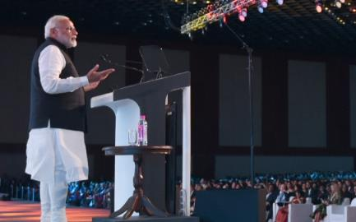




THE WORLD SEES A NEW INDIA
India Becomes the Global Growth Engine
India remains the world’s fastest growing large economy
India’s GDP in Current Prices increased by 31% between 2013 & 2017 while the Global GDP increased by 4%
India rated highly on all investment and macro-economic indicators
As on 1st February 2019

Slide 13



THE WORLD SEES A NEW INDIA
Yoga Goes Global
Ahead of International Yoga Day, United Nations headquarters lit up in New York
Entire world celebrates Yoga Day on 21st June with great enthusiasm
Yoga inscribed on the Representative List of the Intangible Cultural Heritage of Humanity in the UNESCO0
As on 1st February 2019

Slide 14
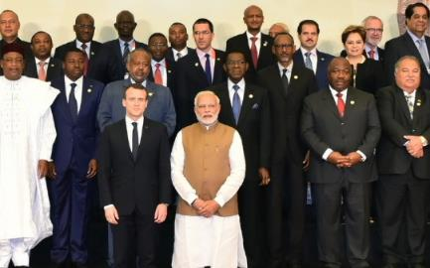






THE WORLD SEES A NEW INDIA
India Leads the Fight Against Climate Change
India played a leading role at COP21
in Paris
India spearhead
Solar Alliance with a commitment of
₹175 crore for setting up of ISA
PM Modi inaugurated the first assembly of ISA on
October 2, 2018
Cabinet approved resolution to open ISA membership to all countries that are members of UN on Nov. 1, 2018
As on 1st February 2019

Slide 15
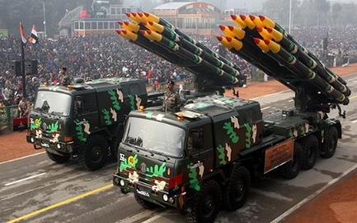

THE WORLD SEES A NEW INDIA
Protecting Motherland with
Full Might
In a historic first, India carried out Surgical Strikes showing a new mettle
Long pending demand of One Rank One Pension Fulfilled, over ₹35,000 crore distributed
Modernisation of Defence forces going on at full pace
INS Arihant completed its first deterrence patrol, establishing India’s Nuclear Triad
As on 1st February 2019

Slide 16
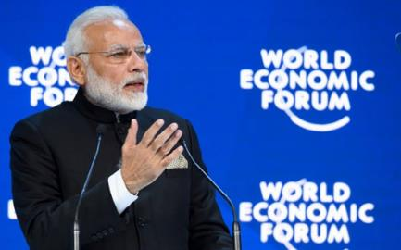




THE WORLD SEES A NEW INDIA
New Might of a
New India
In a historic first, the world heard the India Story from PM Modi at World Economic Forum Davos
India secured representation in International Tribunal for the Law of the Sea, International Maritime Organization & Economic and Social Council
Subsequent to inclusion in MTCR in 2017, India secures membership of Wassenaar Arrangement & Australia Group in 2018
In the last 4 years,
India’s relations with
other nations have
seen significant
improvement
As on 1st February 2019

Slide 17
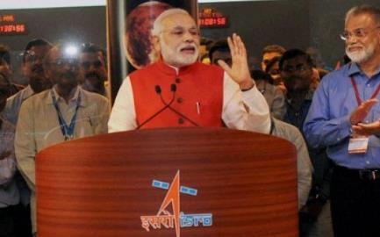

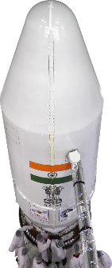

THE WORLD SEES A NEW INDIA
Jai Vigyaan
ISRO sets a World Record by launching
104 Satellites in a single flight
India’s most-advanced communication satellite GSAT 11 & multi-band satellite GSAT-29 launched to increase Hi-speed communication and broadband facilities
With IRNSS-1G, India joined elite list of countries with their own satellite navigation system NavIC.
First Asian country to launch Mars Orbit Mission with Mangalyaan
As on 1st February 2019

Slide 18
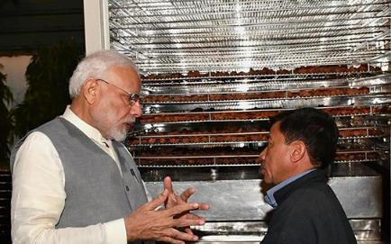


THE WORLD SEES A NEW INDIA
India leading the Global Shift towards Renewable Energy
India’s Standing in Global Renewable Energy Installed Capacity
Wind Power
Solar Power
Renewable Energy
4th
5th
5th
Renewable energy installed capacity
73.35 GW
In last 4 years, Govt. has invested over
USD $40 billion in green energy space
35.51 GW
2014
Oct 2018
As on 1st February 2019

Slide 19
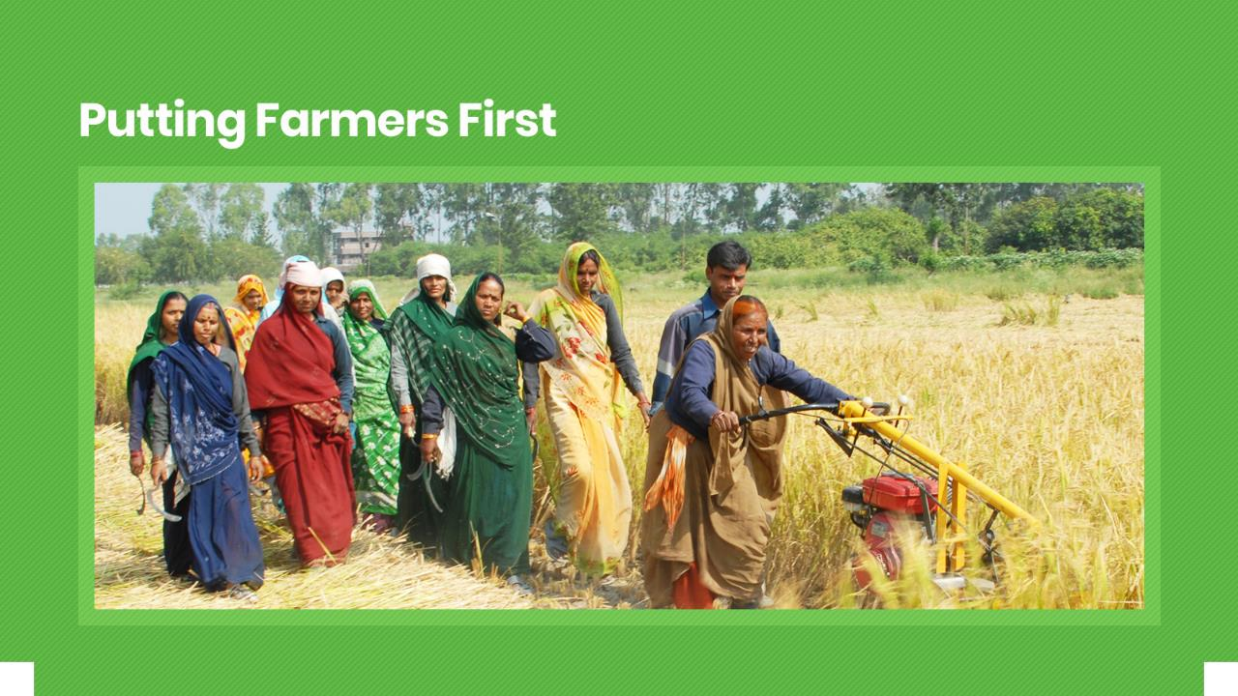

Slide 20
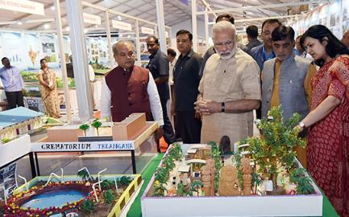







PUTTING FARMERS FIRST
Multi-faceted Focus on Doubling
Farmers’ Incomes
Special focus on irrigation with the aim of
“Per Drop More Crop”
Creation of a National Farm Market, removing distortions and e-platform across 585 Stations
Provision of quality seeds and nutrients
based on soil health of each field
Introduction of a New Crop Insurance Scheme
to mitigate risks at an affordable cost
Large investments in Warehousing and Cold Chains to prevent post-harvest crop losses
Promotion of ancillary activities like poultry, beekeeping and fisheries
Promotion of value addition through food
processing
As on 1st February 2019

Slide 21
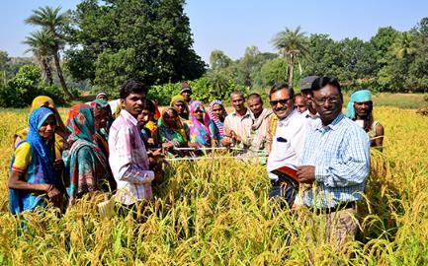






PUTTING FARMERS FIRST
Record Budgetary Allocation for
Record Outcomes
Farm Credit Target raised to
₹11 lakh crore for 2018-19
₹2,000 cr for Agri-market infrastructure fund set up
Corpus of ₹10,000 cr
to create infrastructure in fishery, aquaculture and animal husbandry sectors
₹1,290 cr allocated under
National Bamboo Mission to help setting up small industries
Tax incentives to promote
post-harvest agricultural activities
As on 1st February 2019

Slide 22
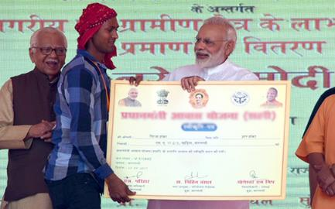





PUTTING FARMERS FIRST
Standing with Farmers in Times
of Need
Relief to farmers in distress given in case of 33% and more damage to the crop;
earlier it was for 50%
For food grains damaged due to excessive rainfall, full minimum support price
to be paid
Families of the deceased persons to be given an assistance of ₹4 lakhs, up from ₹2.5 lakhs
82% rise in provision under SDRF* during 2015-20, as compared to 2010-15.
It went up to ₹61,220 Crore from ₹33,580.93 Crore
*State Disaster Relief Fund
As on 1st February 2019

Slide 23
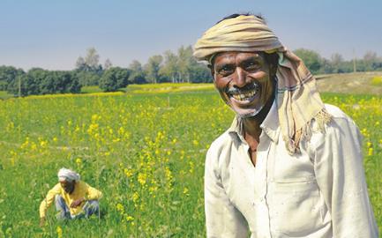
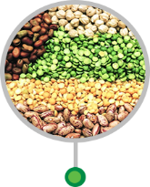


PUTTING FARMERS FIRST
Unprecedented Support to Farmers with Record Procurement
64 lakh metric tonnes of Pulses and Oilseeds were procured at MSP from farmers in 2014-18
Extent of buffer stock of Pulses
increased from 1.5 lakh tonnes to 20 lakh tonnes
Record procurement of 45.43 lakh metric tonnes of pulses under Price Support Scheme
As on 1st February 2019

Slide 24
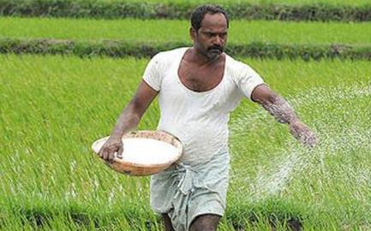






PUTTING FARMERS FIRST
Greater Access and Availability of Fertilizers
100 % Neem Coating resulted in improvement in soil health, reduction in pest and disease attack
Led to Increased Nitrogen Use Efficiency and increased crop yield
Special Banking arrangement of ₹10,000 cr to clear fertilizer subsidy dues
Significant increase in Urea
Production with New Urea Policy
A reduction in the MRP of DAP*, MOP** and Complex fertilizers
*Diammonium Phosphate
**Muriate of Potash
As on 1st February 2019

Slide 25
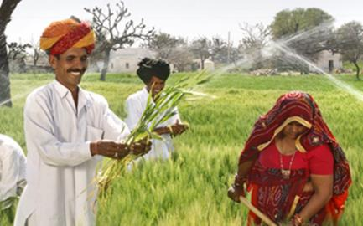







PUTTING FARMERS FIRST
Ensuring More Crop Per Drop
Pradhan Mantri Krishi Sinchai Yojana
₹ 50,000 crores to be invested
to achieve ‘Har Khet Ko Paani’
Dedicated Micro Irrigation fund of
Rs. 5000 crores
Dedicated Micro Irrigation fund of
₹ 5000 crores
Over 32.47 lakh hectare covered
under micro irrigation since 2015-16
Facilitating farmers for installing
solar water pumps in field irrigation
Facilitating farmers for installing
solar water pumps in field irrigation
99 old irrigation projects to be completed in few months
As on 1st February 2019

Slide 26





PUTTING FARMERS FIRST
Helping Farmers get the
Right Price
Electronic National Agriculture Market e-NAM
e- Trading platforms,
585 regulated markets to fetch best prices for farmers
More than 1.47 crore farmers
and sellers are registered
Over 2.31 crore tonnes of farm commodities worth ₹61,098 crore transacted on e-NAM
As on 1st February 2019

Slide 27
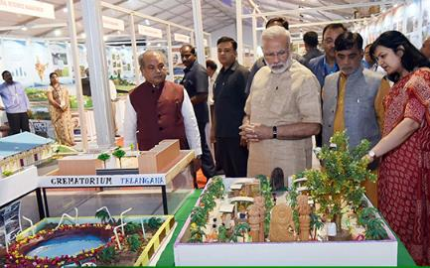







PUTTING FARMERS FIRST
Unprecedented Price Support to Sugarcane Industry
Raise in Procurement Price of Ethanol derived from sugarcane juice
₹52.43/L
₹59.13/L
₹47.13/L
₹47.13/L
Financial assistance of ₹13.88/quintal
to sugar mills to clear cane dues of farmers
Partial sugarcane juice
100% sugarcane juice
Assistance to sugar mills towards transport & logistics ranging from ₹1000/MT to ₹3000/MT
As on 1st February 2019

Slide 28
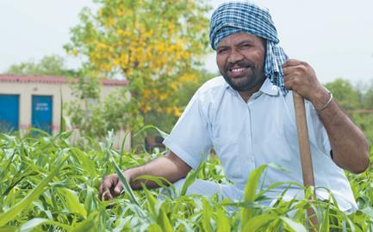




PUTTING FARMERS FIRST
Historic Rise in MSPs of All Kharif Crops
Hike in MSP for all
14 Kharif crops to be
marketed in 2018-19
Season
Raise in MSP ranging
from ₹200 to ₹1827 per quintal
Ensuring 50% to 97%
return over cost of
production
To boost production,
improve nutritional
security & reduced import
As on 1st February 2019

Slide 29
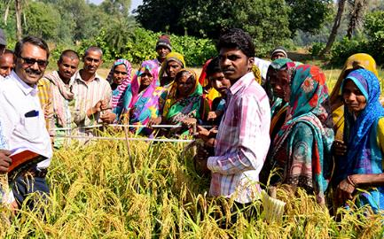







PUTTING FARMERS FIRST
Unprecedented Hike in MSP of All Rabi Crops
Cost of production per quintal
MSP (2019-20)
*Return over cost of production (%)
Wheat
Masur
Gram
₹1840
₹4475
₹4620
112.5%*
76.7%*
75.2%*
₹866
₹2532
₹2637
Barley
Rapeseed & Mustard
Safflower
₹1440
₹4200
₹4945
67.4%*
89.9%*
50.1%*
₹860
₹221
₹3294
As on 1st February 2019

Slide 30





PUTTING FARMERS FIRST
Ensuring Remunerative Prices to Farmers
PM Annadata Aay Sanrakshan Abhiyan launched
Price Support
Scheme (PSS)
Price Deficiency Payment
Scheme (PDPS)
Pilot of Private
Procurement & Stockist
Scheme (PPPS)
Government guarantee
increased to
Physical procurement of pulses, oilseeds & Copra by Nodal Agencies.
Govt. to bear procurement expenditure & losses
To cover all oilseeds for
which MSP is notified.
Farmers to get direct payment to the difference between MSP & selling price
Private sector participation in procurement operation to be piloted
₹45,550 crore
As on 1st February 2019

Slide 31
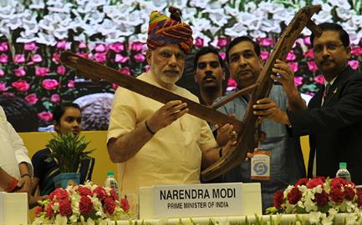



PUTTING FARMERS FIRST
Agricultural Growth Gathers New Momentum
Agricultural Growth
4.55%
3.8%
2.8%
H1
H2
2017-18
H1
2018-19
As on 1st February 2019

Slide 32
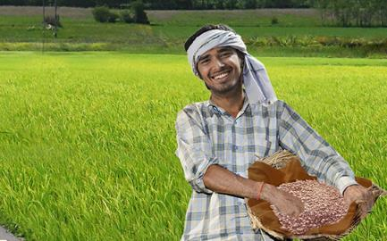







PUTTING FARMERS FIRST
Agriculture Export Policy 2018
Double agricultural exports from present $ 30+ billion to over $60 billion by 2022
Farmers to get benefit of export opportunities in overseas market
Promote ethnic, organic & traditional and non-traditional Agri products exports
Establish Monitoring Framework to oversee implementation of Agricultural Exports Policy
As on 1st February 2019

Slide 33
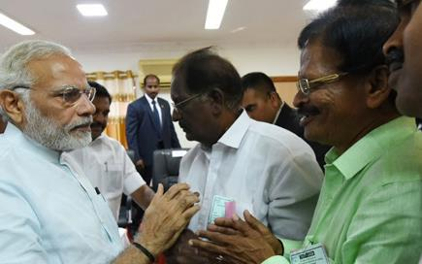




PUTTING FARMERS FIRST
Historic Farmers Income
Support Scheme
Budget 2019-20 Proposal
PM Kisan Samman Nidhi Yojana (PM-KISAN)
12 crore marginal farmers to be provided with yearly income of ₹6000
2% interest subvention for Animal husbandry & Fisheries activities; additional 3% in case of timely repayment
Outlay for Rashtriya Gokul mission increased to
₹ 750 crore
Interest subvention of 2% during disaster to be provided
As on 1st February, 2019

Slide 34
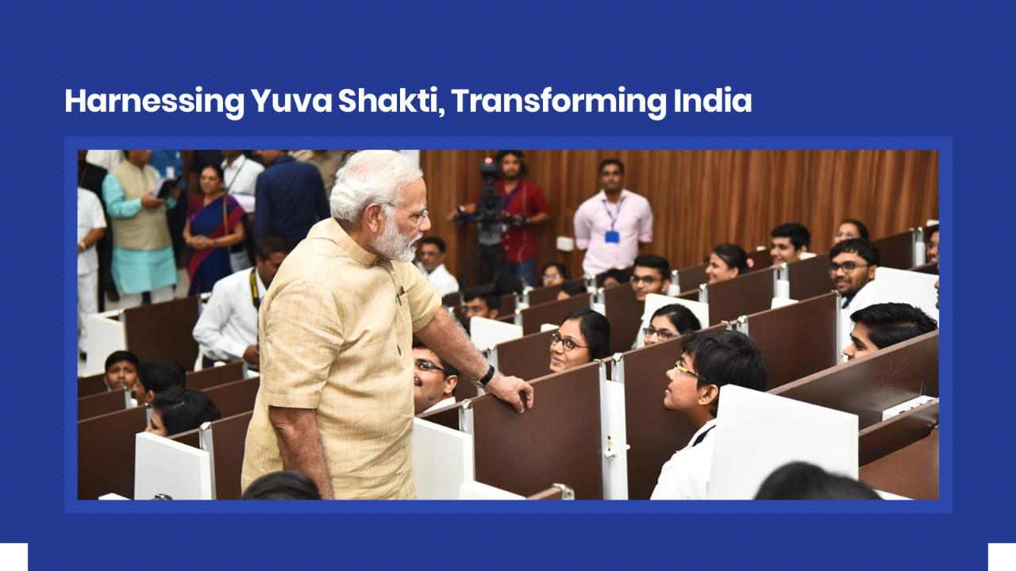

Slide 35
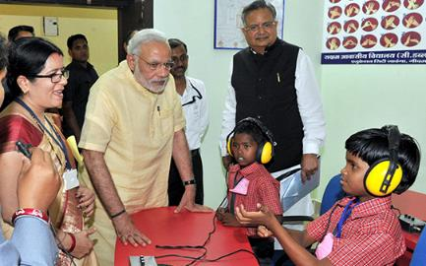










HARNESSING YUVA SHAKTI
Transforming Education, Furthering Empowerment
Overhauling the School Education Apparatus
For building
innovative skills
5,441 Atal Tinkering Labs sanctioned in schools to engage over 60 lakh
students
To boost
educational infrastructure in tribal areas, 462 new
Eklavya Model Residential Schools
to be set up
54,000 ramps & railings built and 50,000 special toilets for Divyang children
As on 1st February 2019

Slide 36
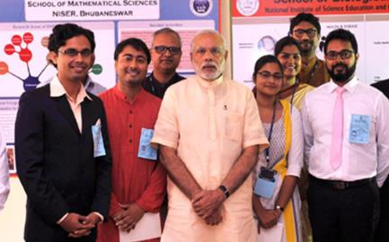




HARNESSING YUVA SHAKTI
Transforming Education,
Furthering Empowerment
Numerous universities, 7 IITs, 7 IIMs, 14 IIITs, 14 AIIMS, 4 NIDs, 1 NIT, 2 IISERs, 103 KVs & 62 Navodaya Vidyalayas established and made operational
Recognizing talent with PM Research Fellowship Scholarship worth ₹70,000-₹80,000 per month for 5 years and ₹2 lakh annual grant for PhD & research
20 institutes declared as “Institute of Eminence”
As on 1st February 2019

Slide 37
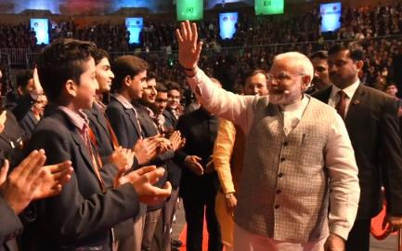



HARNESSING YUVA SHAKTI
Transforming Education,
Furthering Empowerment
60 universities granted graded autonomy. Quality Institutes granted autonomy by passing IIM Bill
National Testing Agency to conduct all professional exams as per International Standard
Vigorous attention devoted to teacher training to produce top quality teachers
As on 1st February 2019

Slide 38
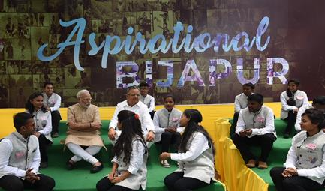






HARNESSING YUVA SHAKTI
Harnessing Yuva Shakti
through Self-Employment
15,649 Start-ups recognised so far
Tax relief for three consecutive years out of a block of seven years for start-ups
Start-ups are allowed to issue ESOPs to promoters working as employees
Funding the unfunded through Mudra Yojana
15.61 crore loans sanctioned including 4.26 crore first time borrowers since April 2015
Allocation in Budget 2018
raised to ₹ 3 lakh crore,
a rise of 20% over previous year
As on 1st February 2019

Slide 39
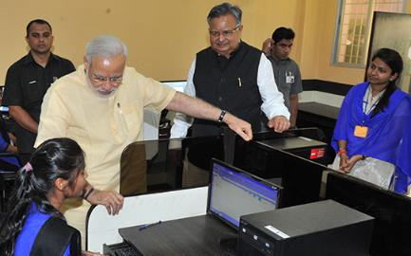
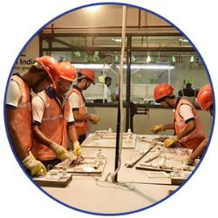
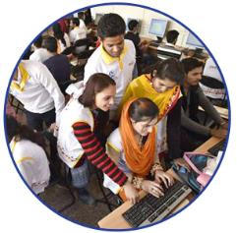
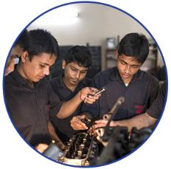

HARNESSING YUVA SHAKTI
Augmenting the Arena of Skill
Development & Vocational Training
Pradhan Mantri Kaushal Vikas Yojana
On average, 1 crore youngsters trained every year
Over 13,000 training centres opened across India training in 375 trades
PM Kaushal Kendras
(PMKK) are being set up in every district across India
As on 1st February 2019

Slide 40
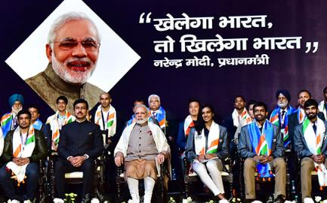





HARNESSING YUVA SHAKTI
Furthering Sports & Sportsmanship Khelo India
Financial assistance of ₹5 lakh/annum for 8 years to talented players
First Khelo India School Games launched on Jan 2018, 3507 players from 29 States and 7 UTs participated
Revamped Khelo India program to have a financial outlay of
₹1,756 crore for 2017-18 to 2019-20
Sports Talent Search Portal launched
A transparent platform for talented youth to share their achievements
As on 1st February 2019

Slide 41


Slide 42





WOMEN LED DEVELOPMENT
Facilitating Well-being of
Expectant Mothers
Maternity Benefit (Amendment) Act 2017
Paid maternity leave extended to 26 weeks (6 months), one of the highest duration in the world so far
49.88 Lakh women paid maternity benefit worth
₹1678.63 Crore (as on 10 December 2018)
Poshan Abhiyan
First of a kind initiative to tackle malnutrition through multi-modal intervention
As on 1st February 2019

Slide 43
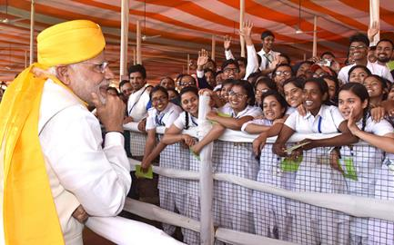





WOMEN LED DEVELOPMENT
From Women Development to Women-led development
Beti Bachao, Beti Padhao
Sex ratio at birth improved
in 104 identified districts
Rising enrollment
of girls in secondary schools
Multiple scholarship
for education of girls
119 districts have reported progress in first trimester registration
146 districts
have reported improvement
in institutional deliveries
As on 1st February 2019

Slide 44
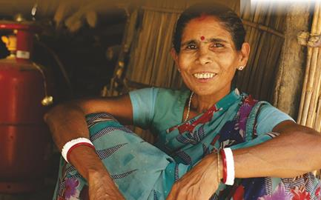




WOMEN LED DEVELOPMENT
From Women Development to
Women-led development
Pradhan Mantri Ujjwala Yojana
Number of LPG Connections
to Household
12 Crore
13 Crore
Target to provide LPG connections enhanced to 8 Cr Women & benefits extended to all left out poor families
6.26 Cr women
have got LPG connections
Until 2014
2014-18
As on 1st February 2019

Slide 45







WOMEN LED DEVELOPMENT
Supplementing skills and supplying capital for Nari Shakti
This scheme provides collateral free loans to entrepreneurs
This initiative provides loans of up to ₹1 crore to women /SC/ST/OBC entrepreneurs
Over 9 crore women constituting over 74% of the beneficiaries, benefitted jointly from Mudra & Stand-Up India
Government PSUs to purchase 3% of material from enterprises owned by women
As on 1st February 2019

Slide 46



WOMEN LED DEVELOPMENT
Securing Women Against Violence
Ordinance on Death Penalty for rapists
Provision of Death Penalty for rape of girl child under 12 years
Minimum punishment for rape of a girl under 16 years increased from 10 years to 20 years
As on 1st February 2019

Slide 47







WOMEN LED DEVELOPMENT
Promoting Social Empowerment
for Women
Social Empowerment of Women
Putting women ahead
Bill that empowers Muslim Women against Triple Talaq passed in Lok Sabha
Preference given to Women in Pradhan Mantri Awas Yojana
Muslim Women can now perform Haj without a male guardian
Passport rules relaxed for single mothers
As on 1st February 2019

Slide 48
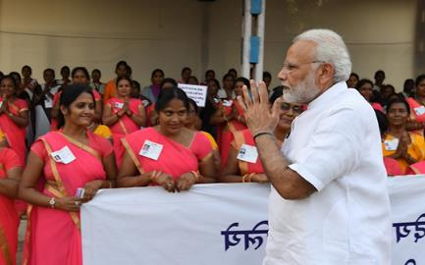



v
WOMEN LED DEVELOPMENT
Historic Pay Hike for Anganwadi Workers
Monthly Honorarium
Existing
Revised
Benefitting about 27 lakh Anganwadi Workers & Anganwadi Helpers
₹4500
₹3000
₹3500
₹2250
₹2200
₹1500
Monthly performance linked incentive of ₹250 to Anganwadi helpers
Anganwadi workers
Anganwadi worker at Mini- AWC
Anganwadi helpers
As on 1st February 2019

Slide 49
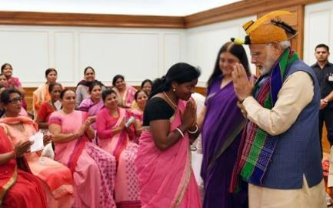




v
WOMEN LED DEVELOPMENT
Empowering ASHA Workers with Benefit Package
ASHAs & ASHA facilitators
enrolled in social security scheme
Routine incentives increased from ₹1000/month to ₹2000 per month benefiting over 10.22 lakh ASHAs
Over 1.06 crore ASHAs & ASHA facilitators covered under PM Jeevan Jyoti Bima Yojana
Supervisory visit charge raised from ₹250 to ₹300/visit, a cumulative increase of ₹1000/month
Over 9.57 lakh ASHAs & ASHA facilitators covered under PM Suraksha Bima Yojana
As on 1st February 2019

Slide 50
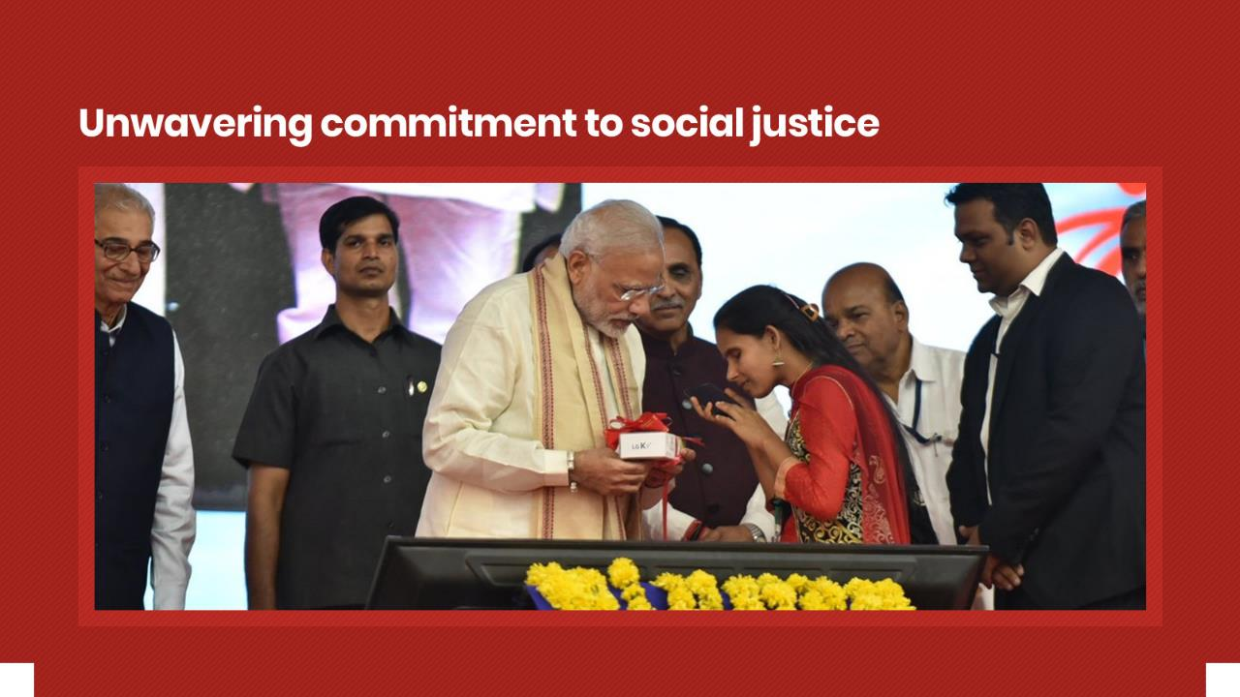

Slide 51
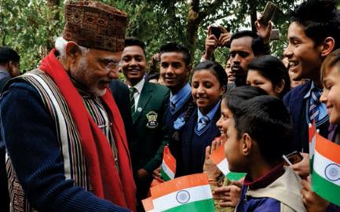





COMMITMENT TO SOCIAL JUSTICE
Fulfilling Aspirations
through Social Inclusion
Historic budget of
for welfare of SC/ ST
Communities
Rs. 95,000 crores
Over 5.7 crore students received scholarship support worth ₹15,918 crore during 2014-2018
Pre-Matric Scholarship for OBCs: Income eligibility raised from ₹44,500 to ₹2.5 lakh
Pre-Matric Scholarship for SC students: Income eligibility raised from ₹2 lakh to ₹2.5 lakhs
Unprecedented rise of 41% in the budget allocation
for OBC welfare in
2018-19 over 2017-18.
As on 1st February 2019

Slide 52
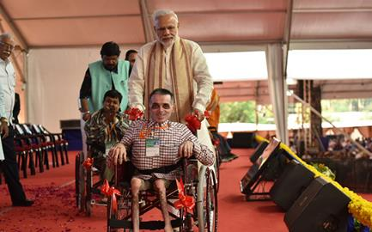




COMMITMENT TO SOCIAL JUSTICE
Accessible India,
Accomplished India
Aids and Assistive equipments worth ₹700 crore distributed to about 12 lakh persons with disabilities
Sugamya Bharat
Abhiyan launched, about 1,000 Government buildings & 650 Railway stations made fully accessible
Access Audit of 1662 important buildings in 50 cities completed till date
Until 2014 only 56 camps organized as compared to monthly average of 140 camps during the last four-and-half years
As on 1st February 2019

Slide 53
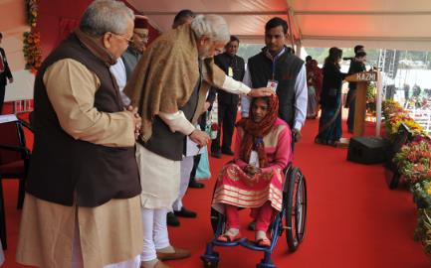





COMMITMENT TO SOCIAL JUSTICE
Setting the Stage for Social Empowerment Rights of Persons
With Disabilities Act, 2016
Types of disabilities increased from existing 7 to 21
Speech and Language Disability and Specific Learning Disability have been added for the first time
Dictionary for Divyangjan with 3,000 words published & 100 websites created to cater them
Right to free education for children with disabilities (6-18 yrs) and Reservation of 4% seats for students in higher education institutions
Penalties for offences committed against Persons with Disabilities (PwDs)
As on 1st February 2019

Slide 54







COMMITMENT TO SOCIAL JUSTICE
Leaving No Stone Unturned
for Justice Strongest Amendments
to SC/ST Act
Establishment of exclusive special courts for the speedy trial of offences of atrocities against SCs & STs
To insert a new chapter relating to “Rights of Victims and Witnesses”
To impose certain duties and responsibilities upon the State for protection of victims, their defendants and witnesses
As on 1st February 2019

Slide 55







COMMITMENT TO SOCIAL JUSTICE
Connecting Young India to
Dr. Babasaheb Ambedkar
Panchteerth: Paying Tribute to Babasaheb by Developing Places Associated with his Life
His birthplace in Mhow
His residence during studies in the U.K.
Deeksha Bhoomi, Nagpur,
where he embraced Buddhism
Dr. Ambedkar International Centre opened in Dec 2017. Foundation stone was laid by PM Modi in April 2015.
Where he attained Parinirvan,
‘Mahaparinirvan Sthal’ in Delhi
His memorial,
‘Chaitya Bhoomi’ in Mumbai
As on 1st February 2019

Slide 56




COMMITMENT TO SOCIAL JUSTICE
Historic Decision Ensuring Equity & Justice For All
The Constitution (103rd Amendment) Act 2019, Brought into Effect
Benefit to EWS who have annual family income below ₹ 8 lakh. Persons whose family own
or possesses
10% reservation in jobs & educational institutions for economically weaker section (EWS) in general category
Residential
Houses Below
1000 feet
square
Residential plot
of less than
100 yards in
municipalities
Residential
plot of less
than 200 yards
in other areas
25% additional seats provided in educational institutions to meet the 10% reservation
5 acres and
below of
agriculture land
As on 1st February, 2019

Slide 57


Slide 58





t
HEALTHY INDIA
Health insurance
cover of up to
₹ 5 lakh/family/yea
Ayushman Bharat
PM Jan Arogya Yojana for Universal Health Coverage
Launched on 23rd September, 2018
Health insurance
cover of up to
₹5 lakh/family/year
Covers secondary
and tertiary care hospitalisation
Providing free treatment in any public or over 16,000 empanelled hospitals across the country
Over 1.04 Crore
beneficiary e-cards generated &
10 lakh beneficiaries
received free treatment worth ₹1,300 crore
As on 1st February 2019

Slide 59





t
HEALTHY INDIA
Health insurance
cover of up to
₹ 5 lakh/family/yea
Ensuring Good Health of
Mother & Child
More than
1.7 Cr
Antenatal check-ups
conducted at over
13,161 health facilities
86.88 lakh
pregnant women
immunized
More than
50 lakh
pregnant women
to benefit every year
with cash incentives of
₹ 6,000
Over
8 lakh
high risk pregnancies identified
As on 1st February 2019

Slide 60



t
HEALTHY INDIA
Health insurance
cover of up to
₹ 5 lakh/family/yea
POSHAN Abhiyaan to Ensure
Proper Nutrition
First of its kind initiative launched to tackle Malnutrition through multi-modal interventions
Target to reduce Malnutrition through Convergence, Use of Technology & a Targeted approach
₹2122.27 crore released for FY 2017-18 & 2018-19. Over 10 crore people to benefit
As on 1st February 2019

Slide 61





t
HEALTHY INDIA
Health insurance
cover of up to
₹ 5 lakh/family/yea
Ensuring Affordable & Quality Healthcare
1084 essential medicines brought under Price Control regime giving consumer total benefit of more than ₹15,000 crore
Price of Cardiac Stents reduced by 85% resulted in annual saving of ₹46,000 crore
Affordable medicines with PM Bhartiya
Janaushadhi Kendras. More than 4,900 stores, resulting in savings of over 50%-90%
Price of Knee Implants reduced by 69% resulted in annual saving of ₹ 1,500 crore
AMRIT pharmacies provide drugs for cancer &
cardiovascular diseases at a discount of 60% to 90%
Over 1.04 crore patients have benefitted (as on 30 Nov.2018)
As on 1st February 2019

Slide 62







t
HEALTHY INDIA
Health insurance
cover of up to
₹ 5 lakh/family/yea
Quality and Affordable Health
Provide free dialysis
services to poor &
subsidized services
to all patients
647 dialysis units and 3953 Dialysis machines made operational
Pradhan Mantri National
Dialysis Program
About 2.5 lakh
patients have availed the service
Nearly 35 lakh
dialysis session
held so far
As on 1st February 2019

Slide 63






t
HEALTHY INDIA
Health insurance
cover of up to
₹ 5 lakh/family/yeai
Eliminating Diseases
One Dose at a Time
India has validated Elimination of
Maternal & Neonatal tetanus in May 2015, before the global target of Dec 2015
MISSION INDRADHANUSH
completed five phases covering 551 districts
(7 Dec. 2018)
Action plans to Measles by 2020 and Tuberculosis by 2025 implemented
86.88 lakh pregnant
female immunized
3.38 crore children
vaccinated
As on 1st February 2019

Slide 64






t
HEALTHY INDIA
Health insurance
cover of up to
₹ 5
Standardization of Allied Healthcare Professionals
Allied and Healthcare Professions Bill, 2018
Setting up of Allied & Healthcare Council of India
& corresponding State Allied Healthcare Councils
15 major professional categories including 53 professions
To directly benefit around 8-9 lakh existing healthcare professionals
Global demand of healthcare workforce projected to be about 15 million by 2030
(WHO Global Workforce, 2030 Report)
Councils to play the role of standard-setter and regulator
As on 1st February 2019

Slide 65


Slide 66




INFRASTRUCTURE FOR NEW INDIA
Building Homes, Nurturing Dreams
Pradhan Mantri Awas Yojana
When India turns 75 in 2022, every Indian should have his or her own home
Loans up to ₹9 lakh and ₹12 lakh get interest subvention of 4% and 3%
Over 1.53 crore
houses built since 2014
only 25 lakh houses constructed during 2009-14
As on 1st February 2019

Slide 67



INFRASTRUCTURE FOR NEW INDIA
Urban Transformation through Smart Cities
100 urban centres chosen as Smart Cities to ensure improved quality of living, sustainable urban planning and development
Various development projects in these cities will cost ₹2,05,018 crores and positively impact about 10 crore Indians
As on 1st February 2019

Slide 68




INFRASTRUCTURE FOR NEW INDIA
More Roads and Highways, Greater Transformation
Expansion of National Highways
EXPENDITURE ON
ROAD CONSTRUCTION
NATIONAL HIGHWAY
NETWORK EXPANDED
SPEED OF CONSTRUCTION
INCREASED
₹1,16,324
crores
1,31,326
km
27 km
per day
Over 1.93 lakh kilometers of rural roads built since 2014
Rural road connectivity up from 56% in 2014 to 91%
92,851
km
12 kms
per day
(as on 9th Aug ‘18)
₹32,483
crores
Average speed of road construction goes up from 69 km/day (2013-14) to 134 km/day (2017-18)
Enhanced road connectivity in every village by 2019 in inaccessible areas
2013-14
2017-18
2013-14
13th Dec. 2018
2013-14
2017-18
2,000 kms of coastal connectivity roads identified for construction and development
As on 1st February 2019

Slide 69




INFRASTRUCTURE FOR NEW INDIA
Railways Development on Track
BEST EVER SAFETY
RECORD IN TRAIN ACCIDENTS
9,528 kms
in 4 years
168% reduction in
consequential train accidents
4,405 kms
7,600 kms
in 5 years
2,926 kms
118
North East is fully integrated with rest of India with the entire network converted to Broad Gauge
44
2009-14
2014 - Mar18
2013-14
2017-18
BROAD GAUGE LINE COMMISSIONED
50% INCREASE IN TRACK RENEWAL
2013-14
30th Nov. 2018
As on 1st February 2019

Slide 70









INFRASTRUCTURE FOR NEW INDIA
Promising Affordable Air Travel Ude Desh ka Aam Nagrik
India emerges as the world’s third largest aviation market
National Civil Aviation Policy-2016 unveiled to transform the sector
For the first time, more people traveled in airplanes than in AC trains
103 operational airports since Independence, UDAN added 40 airports
Domestic air passengers crossed 120 million in 2018
12 lakh seats made available to people at lower tariffs
Regional air connectivity to unserved & underserved airports at subsidized fare of ₹2,500 per hour
As on 1st February 2019

Slide 71




INFRASTRUCTURE FOR NEW INDIA
Deadweight Tonnage*
Harnessing Inland Waterways to Boost Connectivity
India’s First Inland Waterways Terminal on River Ganga Inaugurated
102 operational airports since Independence, UDAN added 34 airports
Regional air connectivity to unserved & underserved airports at subsidized fare of ₹2,500 per hour
First of the 4 multi-modal terminals constructed on National Waterways – I
Completed in a record time under Rs 5369 crore Jal Marg Vikas Project
Enable commercial navigation of vessels of 1,500-2,000 DWT* capacity
Deadweight Tonnage*
As on 1st February 2019

Slide 72



INFRASTRUCTURE FOR NEW INDIA
Thrust to Environment Friendly & Cheaper Fuel
2 crore
PNG connections
& 4,600 CNG stations to be installed in 8 years to cover 70% of population
Foundation Stones laid for City Gas Distribution (CGD) projects in 129 districts
10th CGD Projects Bidding Round launched to cover additional 124 districts
CGD Projects
in 96 cities benefiting 46.5 lakh households & 32 lakh CNG vehicles
(till Sept. 2018)
As on 1st February 2019
CNG is cheaper by 60% & 45% as compared with Petrol and Diesel respectively & PNG is cheaper by 40% as compared to market price LPG

Slide 73






INFRASTRUCTURE FOR NEW INDIA
mv
100% Electrification of Broad Gauge Routes of Indian Railways
₹12,134.50 Cr allocated to
cover 13,675 route kilometres
Railways to save fuel bill up to ₹13,510 Cr per annum
To reduce fossil fuel consumption by
2.83 billion litre/annum
Generate direct employment of
about 20.4 Cr man-days
during construction
As on 1st February 2019

Slide 74





INFRASTRUCTURE FOR NEW INDIA
Deadweight Tonnage*
Significant Steps taken to Clean Ganga
102 operational airports since Independence, UDAN added 34 airports
254 projects worth ₹25,500 Cr approved under Namami Gange program
131 projects sanctioned for 3076 MLD* new sewage treatment plants (STPs)
Rehabilitation on 887 MLD of existing STPs & 4942 km sewer network
10,83,688 household Toilets constructed
& all 4465 villages made ODF
Regional air connectivity to unserved & underserved airports at subsidized fare of ₹2,500 per hour
*Millions of Litre Per Day
As on 1st February 2019
As on 3rd December, 2018

Slide 75


Slide 76





ACCELERATING GROWTH
Bold Reforms,
Stronger Institutions,
Resurgent Economy
Over 35,000 Real Estate projects registered under Real Estate Regulation
Act (RERA)
Over ₹ 1 lakh crore received from Disinvestment proceeds during 2017-18
Opened commercial coal mining sector to private players
Transparent
resource allocation with 89 coal
mines allocated
As on 1st February 2019

Slide 77




ACCELERATING GROWTH
Banking Reforms Fueling the Next Wave of Growth
Historic
Insolvency and Bankruptcy Code
leading to recovery of ₹3 lakh crore by Banks & Creditors
Approval
for PSBs to amalgamate through alternative mechanism to facilitate consolidation
PSBs
recapitalized
by infusing
₹2,60,000 crore to support credit growth & job creation
As on 1st February 2019

Slide 78





ACCELERATING GROWTH
Ease of Compliance
Ensuring Labour Welfare
Shram Suvidha portal:
Unique Labour identification number allocated, online registration of establishments
Minimum wages of labours increased by 42% during the past 5 years
Employees don’t undergo hassles to transfer EPFO accounts any more: Universal Account Number (UAN) boosts portability
The Payment of Wages (Amendment) Act 2017: Empowering workers
As on 1st February 2019

Slide 79





ACCELERATING GROWTH
GST Enhancing Ease of Doing Business and Ease of Living
Small traders
& consumers
benefit
with end of
multiplicity of
taxes
Overall
reduction
in prices
Significant
decrease in
transport
time with
elimination of
check-posts
Reduction in
cascading
effect
of taxes
As on 1st February 2019

Slide 80





ACCELERATING GROWTH
Mega GST Relief for MSMEs, Furthering Impetus to Growth
Exemption from GST for small businesses doubled to ₹40 lakh & ₹20 lakh for special category states
Turnover limits for availing composition scheme raised to ₹1.5 crore from existing ₹ 1 crore
New composition scheme for service providers with a turnover up to
₹50 lakh at 6% GST
instead of 18%
More than 35 lakh small traders, manufacturers & service providers to benefit
As on 1st February 2019

Slide 81





ACCELERATING GROWTH
Enhancing Growth, Simplicity and Transparency with GST
Over 57.5 Lakh New taxpayers registered post GST
(till 30th November 2018)
More than
₹ 91,149 Cr
of GST refunds disposed off
GST provides relief of about ₹80,000 Cr annually to consumers
Above 98%
Items fall
in/below 18% slab
As on 1st February 2019

Slide 82


ACCELERATING GROWTH
India : A Leading Mobile
Manufacturing Hub
Then
Now
Mobile manufacturing units set up
2
268
Mobile handsets
produced
6 Cr
Over 22.5 Cr
Worth of mobile
handsets produced
₹18,992
crore
Over ₹1.32 lakh
crore
As on 1st February 2019

Slide 83






ACCELERATING GROWTH
Strong Macro Economic Fundamentals define India
Economy growing at a robust rate, with GDP growth at 7.6% in First Half of FY 2018-19
WPI Food Inflation Down
Falling Overall Inflation
9.4%
8.48%
1.9%
2.19%
FY 2013-14
FY 2017-18
APRIL 2014
DECEMBER 2018
As on 1st February 2019

Slide 84






ACCELERATING GROWTH
India becomes the
Global Growth Engine
31%
3.3%
4%
2.43%
1.75%
India advanced to
6th largest economy in the world as compared to
11th in 2013-14
2013
2018
2005
2013
2017
GDP growth rate at Current Prices
Growth in India’s share in World GDP
As on 1st February 2019

Slide 85



ACCELERATING GROWTH
India Transforms,
the World Applauds
India Climbed to the 40th rank
WEF’s Global Competitiveness Index
India’s ranking in Ease of Doing Business
leapt 65 places since 2014
77
40
100
71
130
142
2014-15
2017-18
2014
2016
2017
2018
As on 1st February 2019

Slide 86







ACCELERATING GROWTH
India’s Significant Jump in
Ease of Doing Business Ranking
Rank in Key Performance Indicators
CONSTRUCTION
PERMITS
GETTING
ELECTRICITY
RESOLVING
INSOLVENCY
2018
2018
2018
52
24
108
2014
2014
2014
184
137
137
TRADING
ACROSS BORDERS
PAYING TAXES
STARTING
A BUSINESS
2018
2018
2018
80
121
137
2014
2014
2014
126
156
158
As on 1st February 2019

Slide 87


ACCELERATING GROWTH
India’s Growth Gathers New Momentum
7.6%
7.35%
GDP growth at 7.6% in First Half of FY 2018-19
5.95%
H1
H2
H1
2017-18
2018-19
As on 1st February 2019

Slide 88



ACCELERATING GROWTH
Manufacturing Growth Gathers New Momentum
Manufacturing GVA
10.45%
7.1%
5.3%
H1
H2
H1
2017-18
2018-19
As on 1st February 2019

Slide 89



ACCELERATING GROWTH
Growth Rate of Sale of Commercial Vehicles Gathers New Momentum
Growth Rate of Sale of Commercial Vehicles
51.6%
33.9%
30.9%
21%
0
-9.1%
Q1
Q2
Q3
Q4
Q1
2017-18
2018-19
As on 1st February 2019

Slide 90






ACCELERATING GROWTH
PM Unveiled 12 Key Initiatives for Growth of MSMEs
The key initiatives ensure:
Safeguarding Interests of Employees
Easier
Credit
Wider
Markets
Better Technology
Ease of Doing Business
As on 1st February 2019

Slide 91

ACCELERATING GROWTH
Accelerating Port-Led Development in Last 4 Years
Addition in Cargo Handling Capacity of Major Ports
Reduction in Average Turnaround Time
Total Traffic Handled by
Major Ports
Increase in Average Ship Berth Day Output
64 hours
15451 tonnes
1451.59
679.47
12468 tonnes
800.52
94 hours
555.49
2013-14
2017-18
2013-14
2017-18
2013-14
2017-18
2013-14
2017-18
(million tonne per annum)
(metric tonne)
As on 1st February 2019

Slide 92


ACCELERATING GROWTH
Making MSME the Future Growth Engines
Budget 2019-20 Proposal
Atleast 3% of the
25% sourcing
for Government undertakings to be from women owned SMEs
2% interest subvention on an incremental
loan of ₹ 1 crore for GST registered MSMEs
Businesses comprising over 90% of GST payers to be allowed to file quarterly return
As on 1st February 2019

Slide 93





ACCELERATING GROWTH
Easing Lives of Taxpayers
Budget 2019-20 Proposal
TDS threshold on interest earned on bank/post office deposits raised from ₹10,000 to ₹40,000
Individual having annual income upto ₹5 lakh exempted from Income Tax
Standard tax deduction for salaried persons raised from ₹40,000 to ₹50,000
TDS threshold on rental income raised from ₹1.8 lakh to ₹2.4 lakh
As on 1st February 2019

Slide 94


Slide 95





ELIMINATING CORRUPTION
Stringent Action Against Corruption & Black Money
Special Investigation Team set up at the First Cabinet Meeting after the NDA Government assumed office
Efforts against black money brought undisclosed income of about ₹1,30,000 crore under tax
Current proportion of High Denomination notes in our economy is much less than what it would have been without Demonetisation.
Action taken against over 3.38 lakh shell companies
As on 1st February 2019

Slide 96








ELIMINATING CORRUPTION
Enabling Legislations &
Amendments to Curb Corruption
Double Taxation Avoidance Agreement with Mauritius, Cyprus, Singapore
Agreement on real time information sharing
with Switzerland
Black Money (Undisclosed Foreign Income and Assets) and Imposition of Tax Act 2015 enacted
PMLA amended to allow confiscation of property equivalent in value of black money stashed abroad
As on 1st February 2019

Slide 97




ELIMINATING CORRUPTION
Enabling Legislations &
Amendments to Curb Corruption
Benami
Property Act
blocking a major avenue for generation and holding of black money in various forms
Fugitive Economic Offenders Bill
introduced to empower law enforcement agencies to confiscate assets of economic absconders
This would also help banks and other financial institutions to achieve higher recovery from fugitive economic offenders
As on 1st February 2019

Slide 98





ELIMINATING CORRUPTION
Enabling Legislations &
Amendments to Curb Corruption
Over ₹6,06,473 crore directly transferred
into the bank account
of beneficiaries for
437 schemes
Aadhaar given legislative framework
GEM online platform
for transparent public procurement crosses
12.63 lakh transactions worth ₹17,938 Cr with overall savings of 25%- 28%
More than 1 crore Income Tax Payees linked their Aadhaar with PAN
As on 1st February 2019

Slide 99





ELIMINATING CORRUPTION
Cronyism Out, Cleanliness In
Clean auctions of
coal blocks
& telecom Spectrum
set a new
benchmark
Online application made mandatory for all clearances
Time taken for environmental approvals brought down to 180 days from 600 days
No more interviews for non-gazetted posts, Meritorious candidates win
As on 1st February 2019

Slide 100




ELIMINATING CORRUPTION
Tribunals for Speedy Disposal of Cases under Benami Property Transaction Act
Setting up of Appellate
Tribunal to provide appellate mechanism for order passed by Adjudicating Authority
Appointment of Adjudicating Authority along with three Benches at Kolkata, Mumbai & Chennai
₹50,000 crore confiscated under Benami Property Transaction Act
As on 1st February 2019

Slide 101


Slide 102








SPEED & SCALE OF TRANSFORMATION
mr
Connecting India at Express Speed
Rural road connectivity increased from 56% in 2014 to 91% villages
Average speed of
rural road construction
56%
91%
134
KM/Day
69
KM/Day
2013-2014
2017-2018
National Highway Network
Speed of highway construction
27
1,31,326
12
KM/Day
KM/Day
KM
92851
KM
2013-2014
13th Dec. 2018
2013-2014
2017-2018
As on 1st February 2019

Slide 103






SPEED & SCALE OF TRANSFORMATION
mv
Unprecedented Speed, Scale and Safety in Rail Development
50% increase in
track renewal
Broad Gauge line commissioned
168% reduction
in consequential train accidents
2017-2018
2017-2018
2013-2014
118
2013-2014
2013-2014
30th Nov. 2018
44
2,926
4,405
7,600
9,528
KM
KMS
KMS
KMS
KMS
As on 1st February 2019

Slide 104








SPEED & SCALE OF TRANSFORMATION
mv
Holistic Development, Driving Rural India
Toilets built in
rural households
Sanitation
coverage
No. of Common
Service Centres
Gram Panchayats connected by Optical Fibre
9.20 Cr
3.18 lakh
1.16 lakh
98.82%
6.65 Cr
38.70%
83,000
59
2014
Present
2014
Present
2014
Present
2014
Present
As on 1st February 2019

Slide 105



SPEED & SCALE OF TRANSFORMATION
mv
Historic Transformation of Tax Structure Ushered in at a Spectacular Pace
65 lakh
1.2 crore
Number of taxpayers
registered
Pre GST
Post GST
As on 1st February 2019

Slide 106




SPEED & SCALE OF TRANSFORMATION
mv
New Momentum for New India
32.38 Crore LED bulbs distributed which is more than the population of Brazil. Overall savings of
₹16,822 crore per year
Over the last 4 years,
Over 1.53 crore houses constructed in rural and urban areas
As on 1st February 2019

Slide 107



SPEED & SCALE OF TRANSFORMATION
mv
New Paradigms in Financial
Inclusion
A Bank Account for Every Family in
Just 4 Years
Over 34.03 crore Jan Dhan accounts opened, equivalent to the Population of USA
Making Social Security a Nationwide Phenomenon
with Jan Suraksha
More than 19 crore people insured against life and accident risk, or ensured pensions
As on 1st February 2019

Slide 108




SPEED & SCALE OF TRANSFORMATION
mv
Powering a Billion Aspirations
Every village electrified under
Deen Dayal Upadhyaya
Gram Jyoti Yojana
28 States
achieve 100%
household electrification 2.48 Crore
households electrified under Saubhagya
since Oct. 2017
SAUBHAGYA
to ensure universal household electrification
by 31st March 2019
As on 1st February 2019

Slide 109




SPEED & SCALE OF TRANSFORMATION
mv
An Emphatic Increase in Tax Compliance
Number of new Returns filed post demonetisation increased in the past two years by
85.51 lakh and 1.07 crore
6.85 crore
3.79 crore
2013-14
2017-2018
As on 1st February 2019

Slide 110








SPEED & SCALE OF TRANSFORMATION
mv
Unprecedented Scale of Transformation in Telecom Sector
Tele-density
93%
5-Fold jump in FDI inflows in
last 3 years, from $1.3 billion
in 2015-16 to $6.2 billion
(₹43,400 cr) in 2017-18
75%
2014
2018
Internet coverage
Optical Fibre Cable Coverage
Broadband Connections
446 Million
14 lakh km
412 Million
251 Million
7 lakh km
61 Million
2014
2018
2014
2018
2014
2018
As on 1st February 2019

Slide 111






SPEED & SCALE OF TRANSFORMATION
mv
Ensuring Universal Broadband Connectivity
National Digital Communications Policy 2018
Universal broadband connectivity at 50 Mbps to every citizens
1 Gbps connectivity to all Gram Panchayats by 2020 & 10 Gbps by 2022
Train 1 million manpower for
building New Age Skill
Expand IoT* ecosystem to 5 billion connected devices
Establishing
comprehensive data protection regime
*Internet of things
As on 1st February 2019

Slide 112






SPEED & SCALE OF TRANSFORMATION
mv
Unprecedented Growth of IT Returns Filed in Last 4 Years
6.85
Crore
GROWTH OF OVER
80%
INCREASED BY
65%
6.85
Crore
3.79
Crore
Number of
Persons
Filing Return
Number of
Returns Filled
3.31
Crore
2013-2014
2017-2018
2013-2014
2017-2018
As on 1st February 2019

Slide 113















SPEED & SCALE OF TRANSFORMATION
mv
Higher Tax Compliance Over the Last 3 Assessment Years
Gross total income
declared by Return Filers
Number of taxpayers with income
above ₹1 Crore
67%
60%
Average tax paid by
corporate taxpayers
Increased
growth
over 1.4 lakh
55%
44.88 lakh Cr
growth
49.95 lakh
88.6K
26.92 lakh Cr
32.28 lakh
2014-15
2017-18
2014-15
2017-18
2014-15
2017-18
As on 1st February 2019

Slide 114










SPEED & SCALE OF TRANSFORMATION
Demonetisation Boosts Formalisation of Economy
₹5730 Cr
A Quantum Leap in Digital Payments
₹102595 Cr
₹7589 Cr
₹7393 Cr
₹3448 Cr
₹800 Cr
₹300 Cr
₹2 Cr
₹50 Cr
Oct. 2016
Dec. 2018
Before
Demonetisation
Dec. 2018
Before
Demonetisation
Dec. 2018
Sept. 2016
Dec. 2018
BHIM transactions
UPI transactions
Point of Sale (PoS) transactions
E-Commerce transactions
As on 1st February 2019

Slide 115





SPEED AND SCALE OF TRANSFORMATION
Delivering Long Stuck Projects at Express Speed
Western Peripheral
Expressway
Inaugurated on 19th Nov. 2018
Dhola-Sadiya Bridge
Inaugurated on 26th May, 2017
Bogibeel Bridge
Inaugurated on 25th Dec. 2018
Kollam Bypass
Inaugurated on 15th Jan. 2019
construction of 9.15 km India’s Longest Bridge commenced in 2011 but stalled for years. The project was revived in 2015
Work on 4.94 India’s
longest rail-cum-road bridge initiated in 2002, only 58% completed until 2014
13.14 km Bypass planned in 1972, only 4.5km stretch completed in 1999. Work on 8.6km started in May 2015reas
Work on 135 km
Kundli -Manesar stretch started post 2014, while the original deadline was 2009
As on 1st February 2019

Slide 116













SPEED AND SCALE OF TRANSFORMATION
Major Boost in Budget Allocations 2019-20 VS 2013-14
Budget Allocations 2013-14
Budget Allocations (proposed) 2019-20
MGNREGA
Welfare of SCs
Welfare of STs
Defence Budget
ICDS*
₹60,000
crores
₹50,086
crore
₹3,05,296
crore
₹27,584
crore
₹76,801
crore
₹33,000
crores
₹24,598
crore
₹41,561
crore
₹2,03,672
crore
₹17,700
crore
2013-14
2019-20
2013-14
2019-20
2013-14
2019-20
2013-14
2019-20
2013-14
2019-20
*Integrated Child Development Scheme
As on 1st February, 2019

Slide 117
Thank You

